Slide 1
KAG 2000 Thermal Desorption Unit
Soil, Water & Vapour Remediation Technology

Slide 2
Introduction
• Mobile, modular, high-throughput remediation
• Closed-loop system with zero atmospheric emissions
• Designed for international deployment

Slide 3
Technical Specifications
• Throughput: 8–10 tons/hour
• Power: 250 kW Generator (upgradable)
• Max Operating Temp: < 450°C
• Construction: 316L Stainless Steel in service zones
• Automation: PLC + HMI with USB logging
• Environmental Controls: CO₂ cooling, heavy metals capture

Slide 4
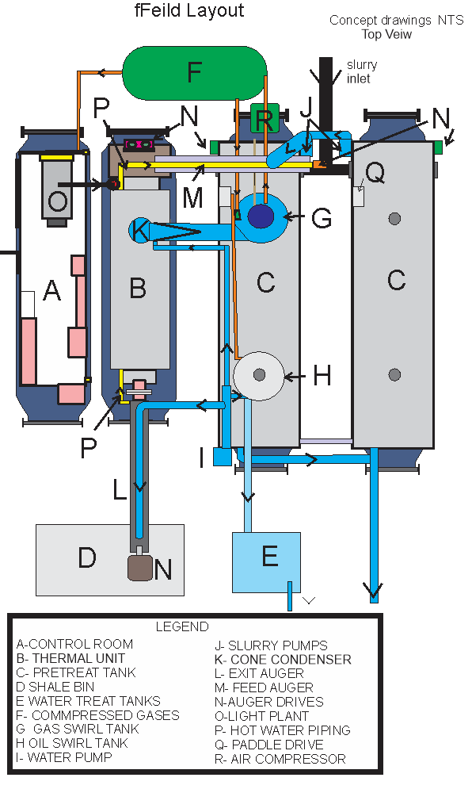

Slide 5
Mobilization
• Transport on flatbed trailers
• Setup with crane and support vehicles
• Utilities connection (power, water, gas)

Slide 6
Operating Procedures
• Automatic feed and auger speed adjustment via VFDs
• Exhaust heat + electric heaters for desorption
• Swirl tank separation with CO₂ injection
• Closed-loop pressure control with bleed-back
• Safety interlocks (pressure, water flow, temperature)

Slide 7
Demobilization
• System purge and cleaning
• Disconnect utilities
• Pack modules into transport-ready configuration

Slide 8
Contact & Closing
Company details placeholder
Space for project-specific branding if required

